Slide 1
Process, Threads & Concurrency

Slide 2
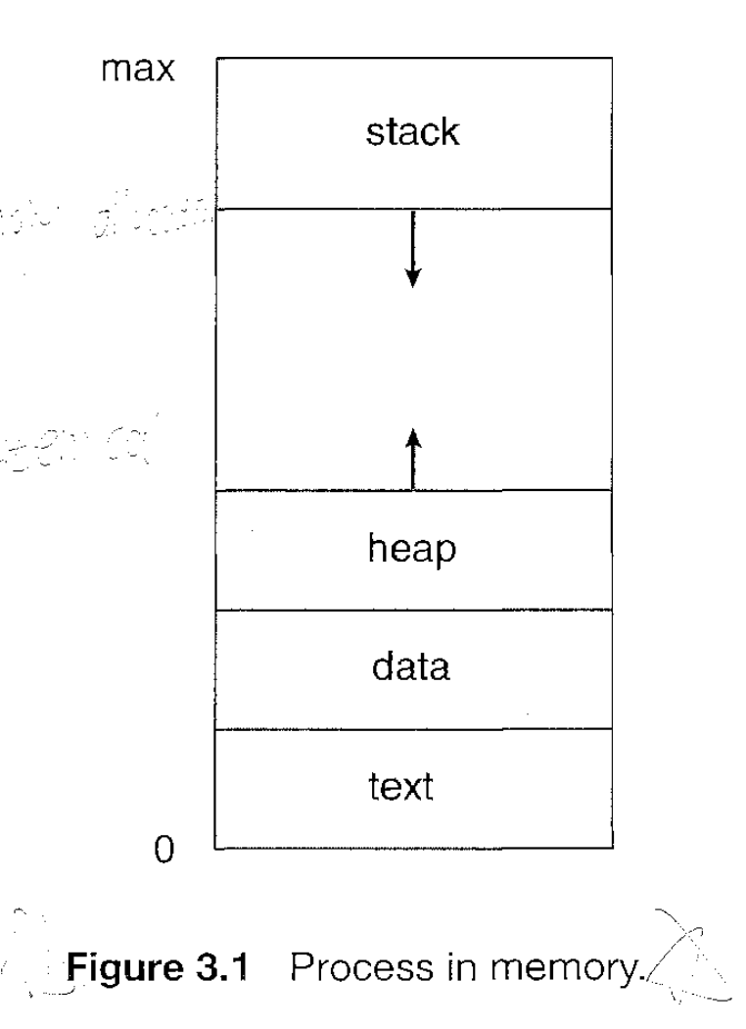
The structure of a process in memory
text section: program code
program counter: current activity and the contents of the processor's registers.
process stack: temporary data (such as function parameters, return addresses, and local variables), and
data section: contains global variables.
heap: memory that is dynamically allocated during process run time.

Slide 3
Process State
As a process execute, it changes state.
New. The process is being created.
Running. Instructions are being executed.
Waiting. The process is waiting for some event to occur (such as an I/0 completion or reception of a signal).
Ready. The process is waiting to be assigned to a processor.
Terminated. The process has finished execution.

Slide 4
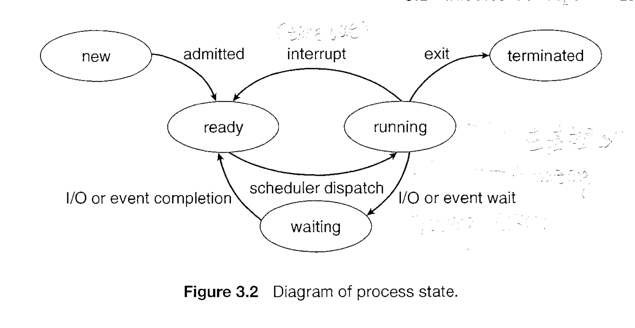

Slide 5
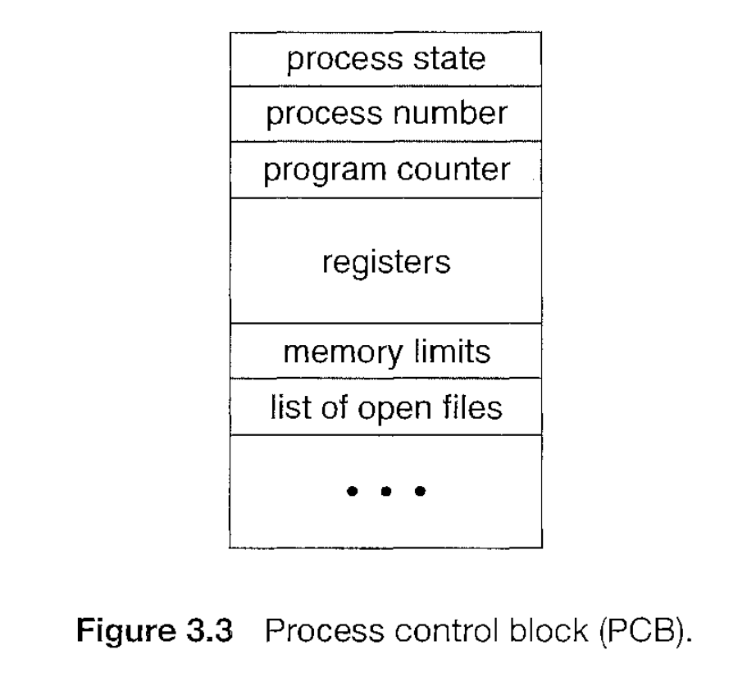
Process Control Block
Process state. The state may be new, ready running, waiting, halted, and so on.
Program counter. The counter indicates the address of the next instruction to be executed for this process.
CPU registers.
CPU-scheduling information.
Memory-management information.
Accounting information.
I/O status information.

Slide 6
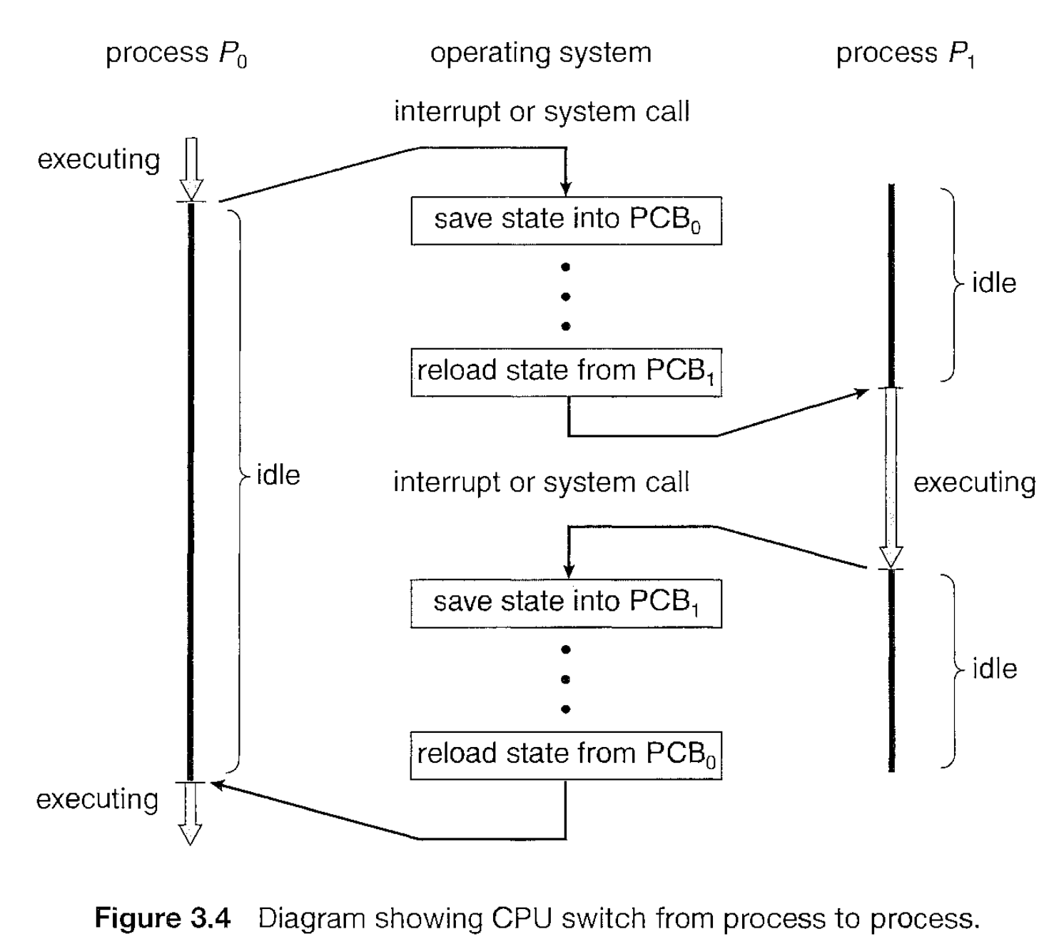

Slide 7
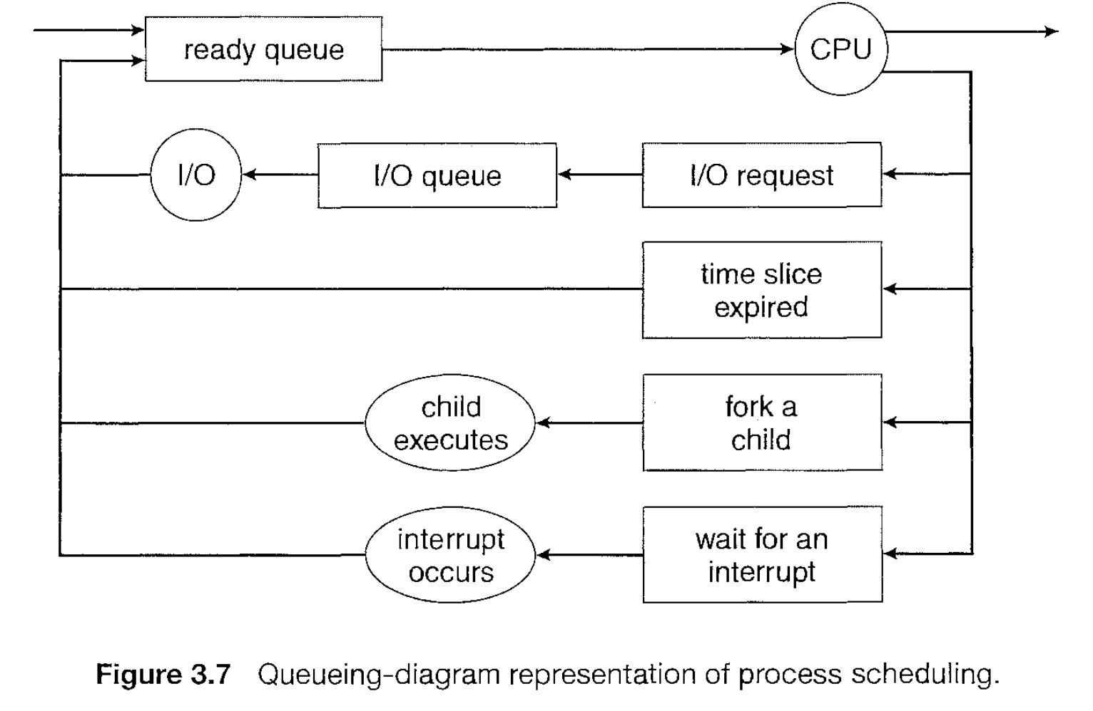
Process Scheduling
Scheduling Queues
  job queue, ready queue, device queue.
Schedulers
  The long-term scheduler, or job scheduler, selects processes from this pool and loads them into memory for execution.
  The short-term scheduler, or CPU scheduler, selects from among the processes that are ready to execute and allocates the CPU to one of them.
Context Switch

Slide 8
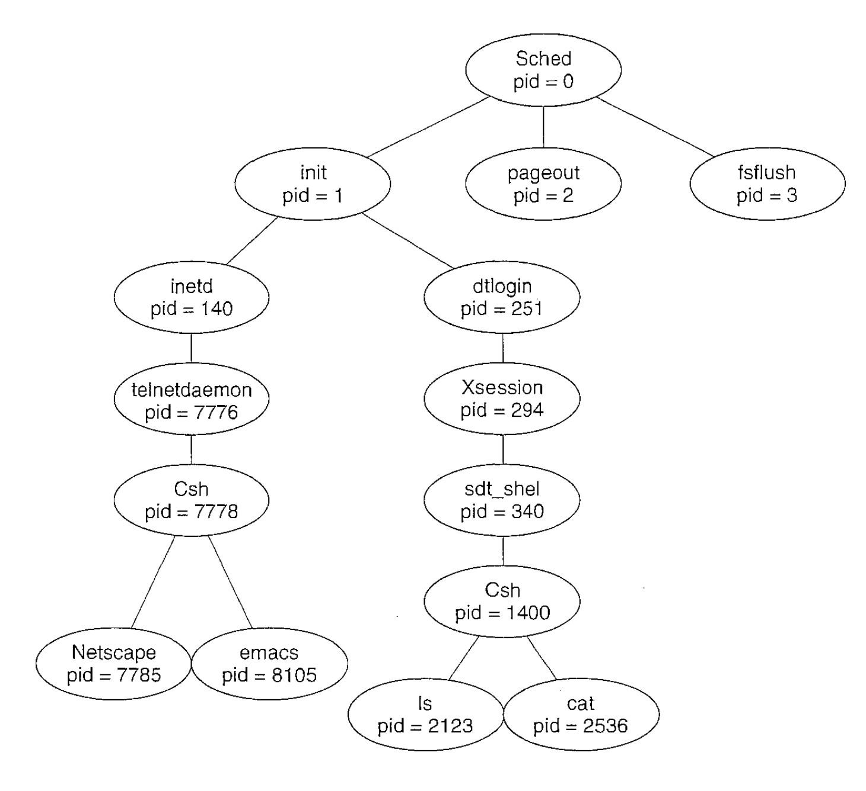
Process creation
When a process creates a new process, two possibilities exist in terms of execution:
The parent continues to execute concurrently with its children.
The parent waits until some or all of its children have terminated.

Slide 9
Process creation
There are also two possibilities in terms of the address space of the new process:
The child process is a duplicate of the parent process (it has the same program and data as the parent).
The child process has a new program loaded into it.

Slide 10
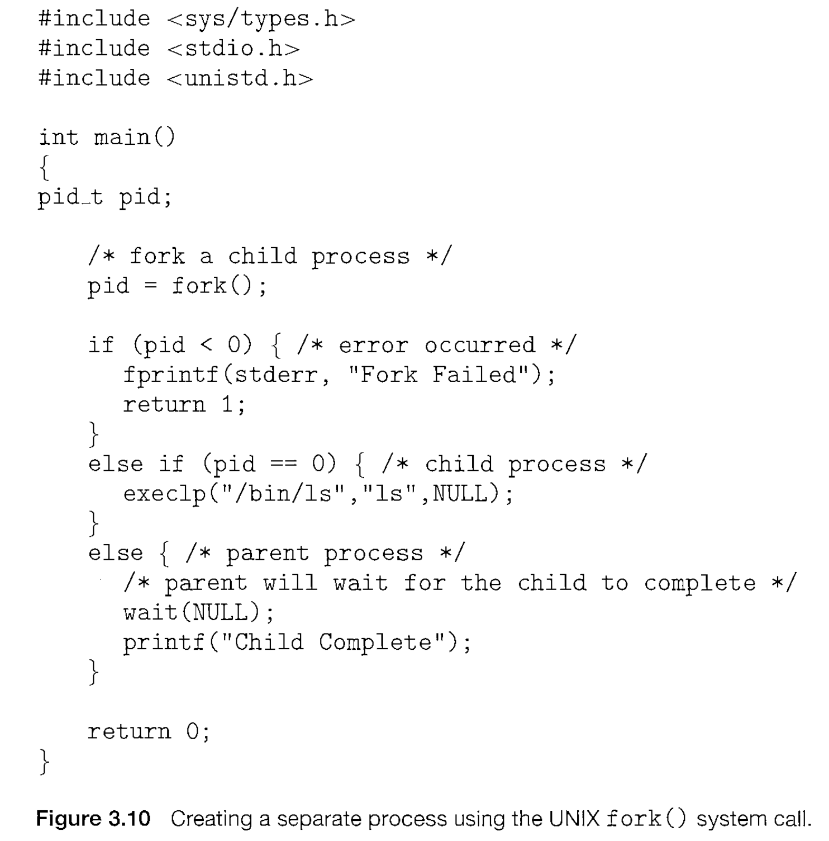
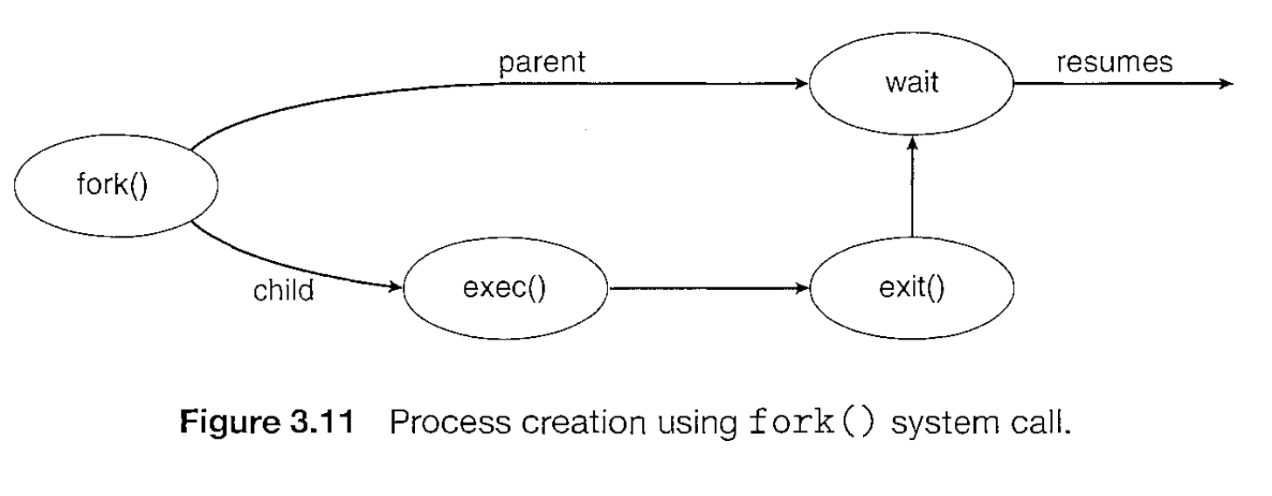

Slide 11
A parent may terminate the execution of one of its children for a variety of reasons, such as these:
The child has exceeded its usage of some of the resources that it has been allocated. (To determine whether this has occurred, the parent must have a mechanism to inspect the state of its children.)
The task assigned to the child is no longer required.
The parent is exiting, and the operating system does not allow a child to continue if its parent terminates.

Slide 12
Interprocess Communication
There are several reasons for providing an environment that allows process cooperation:
Information sharing. Since several users may be interested in the same piece of information (for instance, a shared file), we must provide an environment to allow concurrent access to such information.
Computation speedup. If we want a particular task to run faster, we must break it into subtasks, each of which will be executing in parallel with the others.
Modularity. We may want to construct the system in a modular fashion, dividing the system functions into separate processes or threads
Convenience. Even an individual user may work on many tasks at the same time. For instance, a user may be editing, printing, and compiling in parallel.

Slide 13
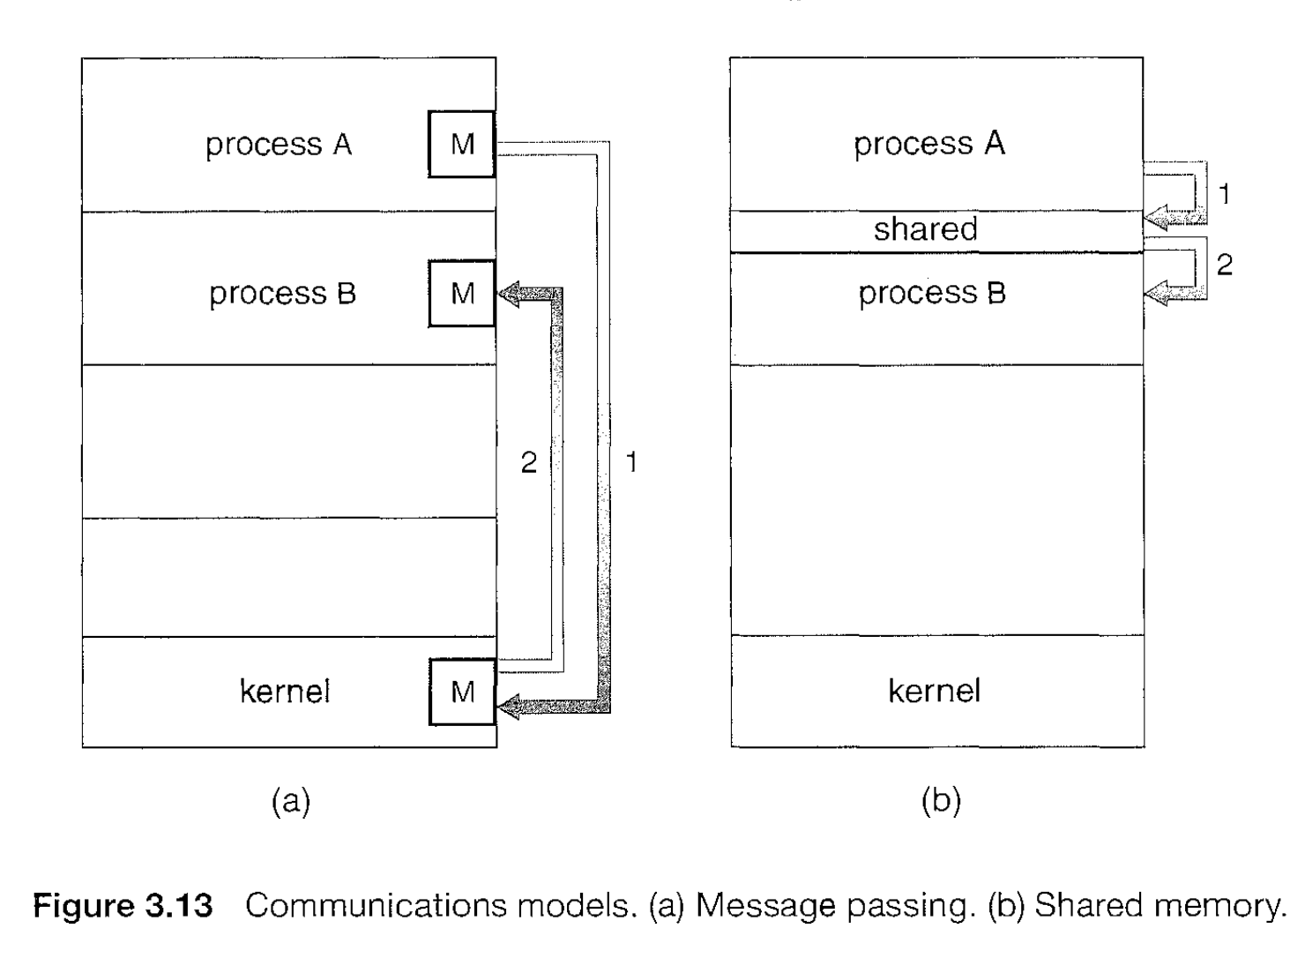
interprocess communication (IPC)
Cooperating processes require an interprocess communication (IPC) mechanism that will allow them to exchange data and information.
shared memory
  a region of memory that is shared by cooperating processes is established. Processes can then exchange information by reading and writing data to the shared region.
  Shared memory is faster than message passing
  system calls are required only to establish shared-memory regions. Once shared memory is established, all accesses are treated as routine memory accesses, and no assistance from the kernel is required.
message passing
  communication takes place by means of messages exchanged between the cooperating processes.
  useful for exchanging smaller amount of data, because no conflicts need be avoided
  Message passing systems are typically implemented using system calls and thus require the more time-consuming task of kernel intervention.

Slide 14
producer-consumer problem
A producer process produces information that is consumed by a consumer process.
Consumer is trying to access information that is not produced by the producer yet
One solution to the producer-consumer problem uses shared memory.
To allow producer and consumer processes to run concurrently, we must have available a buffer of items that can be filled by the producer and emptied by the consumer.
Two types of buffers can be used.
  Unbounded buffer: places no practical limit on the size of the buffer. The consumer may have to wait for new items, but the producer can always produce new items.
  Bounded buffer: assumes a fixed buffer size. In this case, the consumer must wait if the buffer is empty, and the producer must wait if the buffer is full.

Slide 15
Message-Passing Systems
A message-passing facility provides at least two operations: send(message) and receive(message).
Here are several methods for logically implementing a link and the send() and receive() operations:
  Direct or indirect communication
    Direct or
    via a mailbox
  Synchronous or asynchronous communication
    Process is blocked until the message is received or
    process sends the message and resumes operation.
  Automatic or explicit buffering
    Zero capacity.
    Bounded capacity.
    Unbounded capacity.

Slide 16
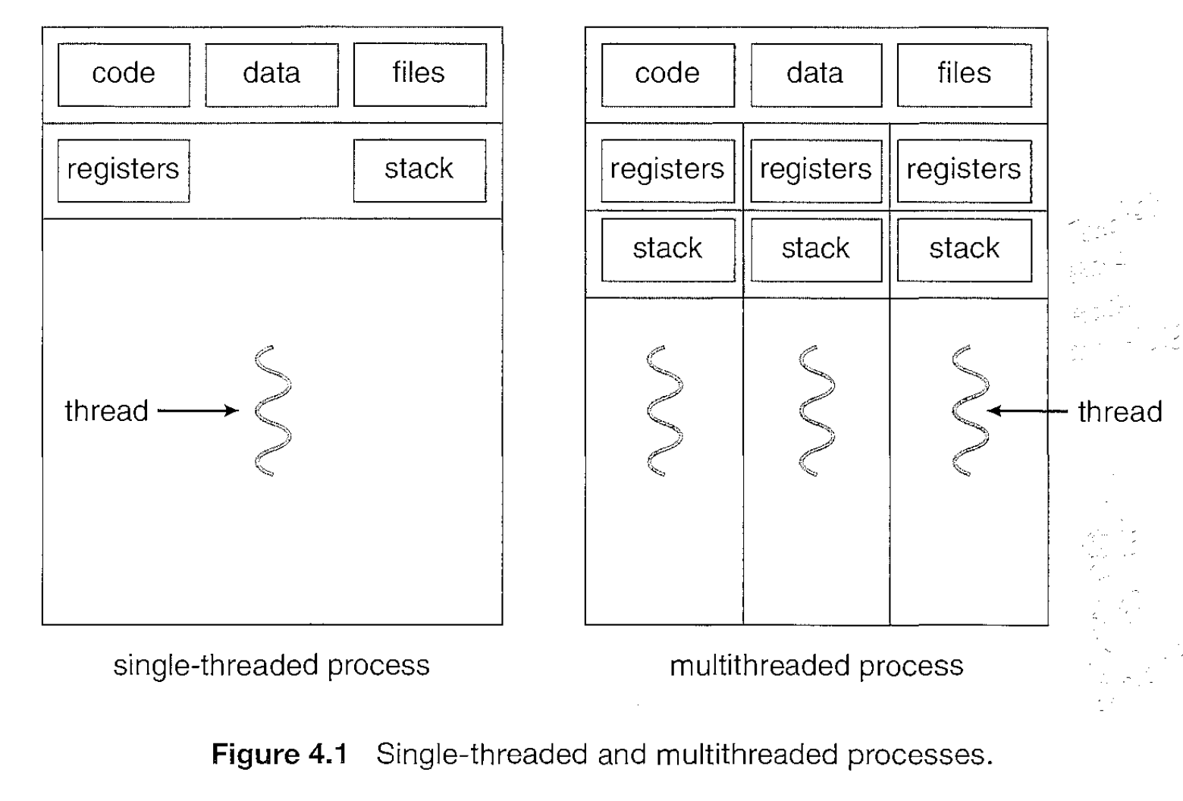
Multithreaded Programming
Thread
For light weighted tasks than process
No system call involved
All user level threads treated as single task for OS
Share same copy of code and data
Context switching is faster
Thread are interdependent
Blocking a thread will block the entire process

Slide 17
Benefits
Responsiveness. Multithreading an interactive application may allow a program to continue running even if part of it is blocked or is performing a lengthy operation, thereby increasing responsiveness to the user.
Resource sharing. Processes may only share resources through techniques such as shared memory or message passing.
Economy. Allocating memory and resources for process creation is costly. Because threads share the resources of the process to which they belong, it is more economical to create and context-switch threads.
Scalability. The benefits of multithreading can be greatly increased in a multiprocessor architecture, where threads may be running in parallel on different processors.

Slide 18
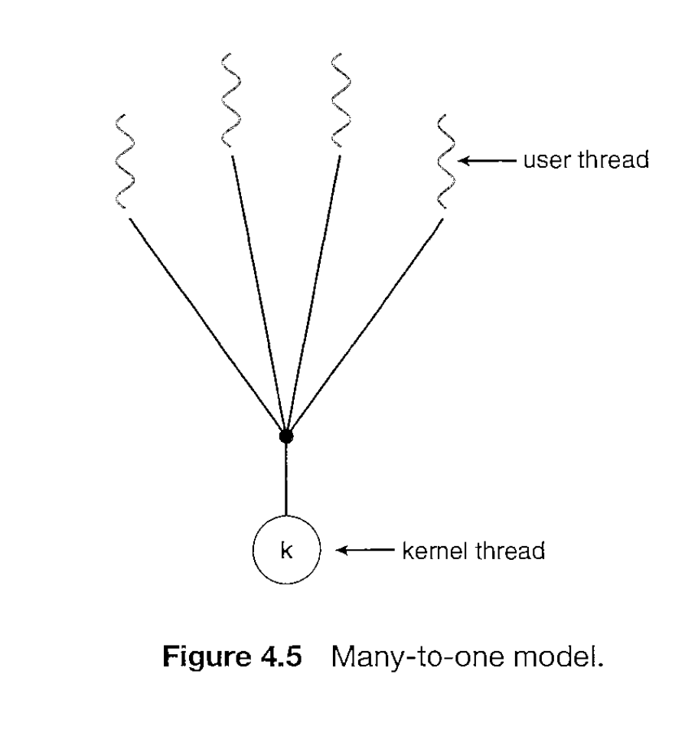
Multithreading models
Many-to-One Model
The many-to-one model maps many user-level threads to one kernel thread.
but the entire process will block if a thread makes a blocking system call
because only one thread can access the kernel at a time, multiple threads are unable to nm in parallel on multiprocessors.

Slide 19
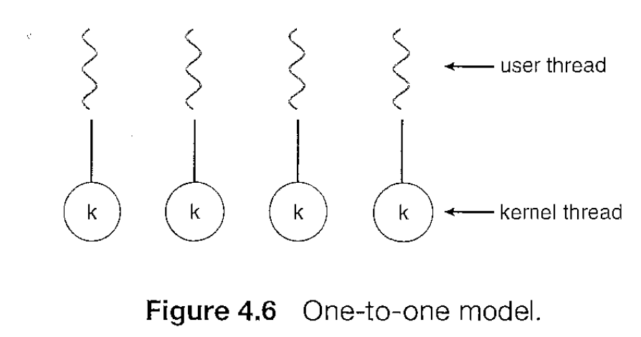
Multithreading models
One to One model:
The one-to-one model maps each user thread to a kernel thread.
provides more concurrency than the many-to-one model by allowing another thread to run when a thread makes a blocking system call
allows multiple threads to run in parallel on multiprocessors.
The only drawback to this model is that creating a user thread requires creating the corresponding kernel thread. Because the overhead of creating kernel threads can burden the performance of an application, most implementations of this model restrict the number of threads supported by the system.

Slide 20
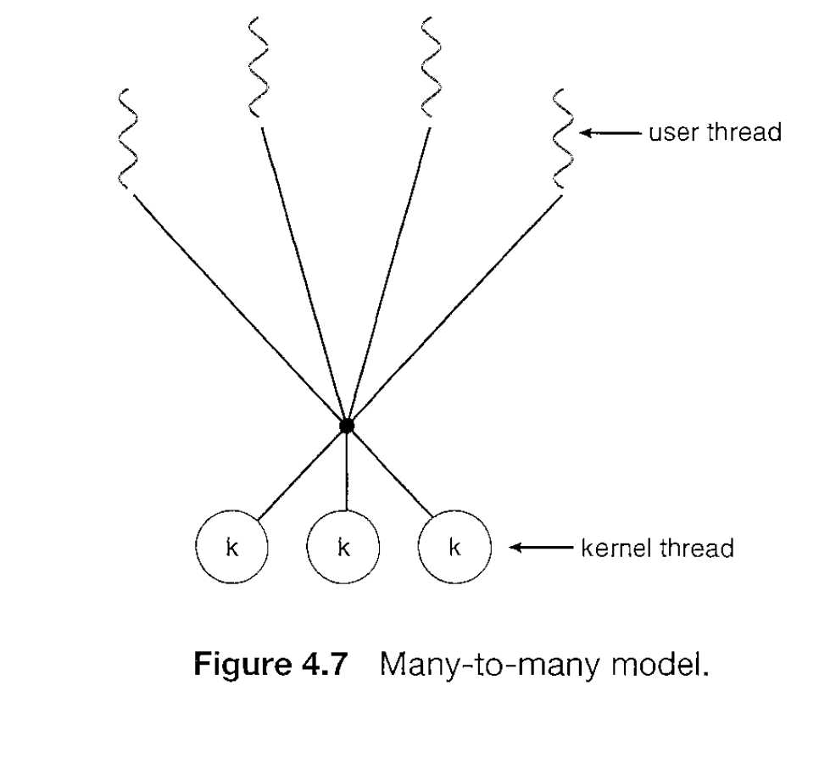
Multithreading models
many-to-many model
The many-to-many model multiplexes many user-level threads to a smaller or equal number of kernel threads.
when a thread performs a blocking system call, the kernel can schedule another thread for execution.

Slide 21
Process Scheduling

